Slide 1
How to Use PowerPoint
Andrea Hirons

Slide 2
Text First!!!
Type in your text
One main point/topic per slide
Or else!

Slide 3
How much info?
Short Bullet Points
Do not write paragraphs!
Use short phrases
5 – 7 words per point
3 – 5 bullet points per slide

Slide 4
How many slides?
2 – 3 Minutes Per Slide
Not 90 slides for 30 minutes, except vacation pics
One slide for every 2 – 3 min of talking

Slide 5
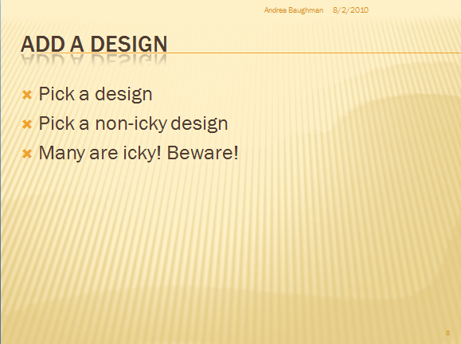
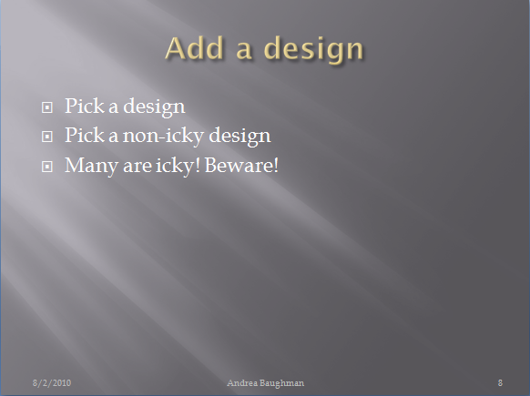
Add a design
Pick a design
Pick a non-icky design
Many are icky! Beware!

Slide 6

Contrast! Have some!
Black text on white background is good!
White text on black is bad!
Tan on beige is just plain evil!
Consider the physics of light and human eyeballs!

Slide 7
Serif or Sans-serif?
Monitors have HUGE dots and don’t do serif well at all!!!!
Serif – has the little/thin flourishes
Sans-serif – blocky and easier to read on screen
Use Sans-serif

Slide 8
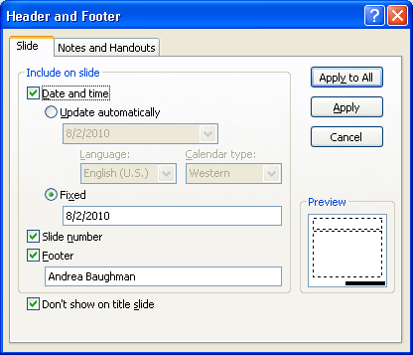
Add footers
Insert, Footer, Check all 4 boxes, Hit apply all
Oh, and type your name in footer field
Now hit apply all again

Slide 9
Finally add pictures
Now, only now, you may add pictures
Copy from source, paste into ppt
Resize so they don’t overlap text
Do not skew/stretch/mangle your pics!
Resize using CORNER handle

Slide 10
Animations and Transitions
Just
Say
No
!

Slide 11
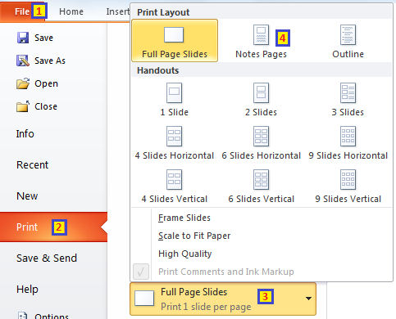
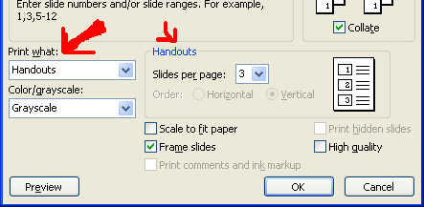
Print What?
Handouts 3-up for audience
Notes pages for you (the speaker)
Handouts 9-up for proofing/overview
Other – mostly a waste of paper

Slide 12
Questions?

